Slide 1
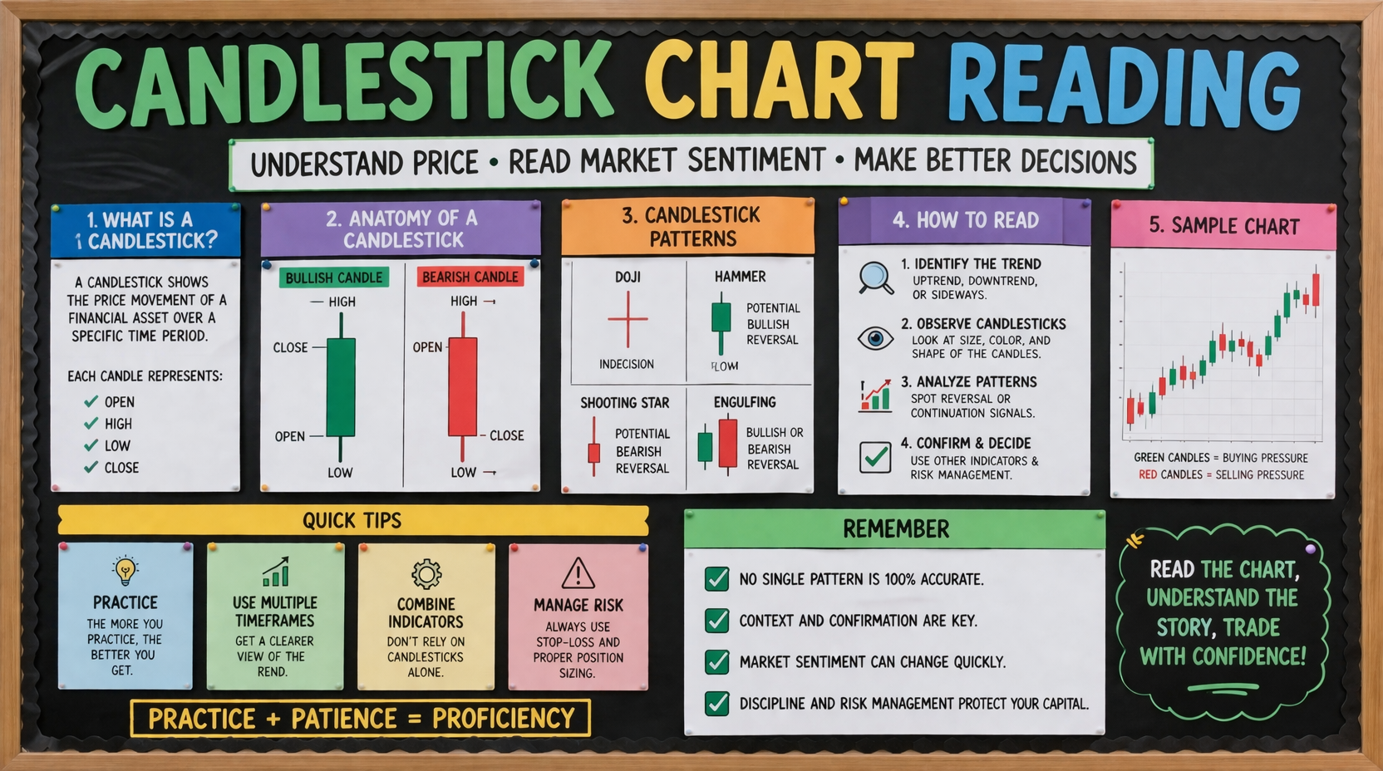
Bulletin Board Presentation
A simple classroom-style guide to reading candlesticks
Notes:
[Sources] - Visual background: AI-generated by OpenAI image tool. [/Sources]

Slide 2
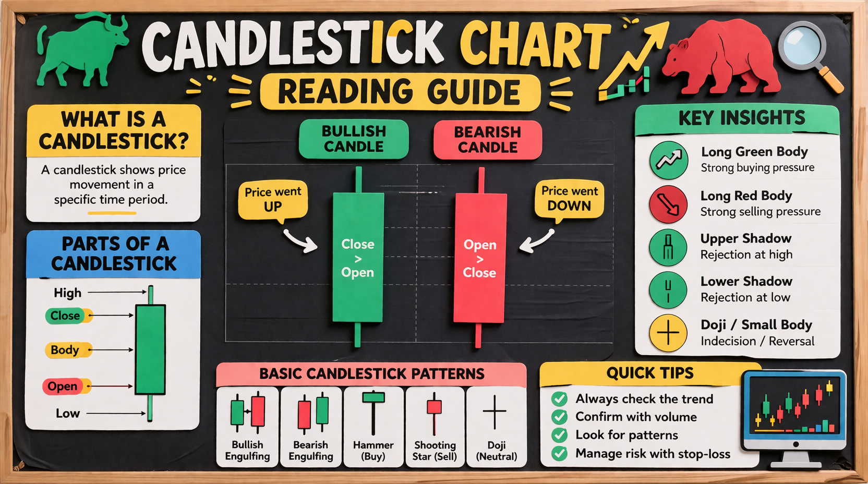
1. Anatomy of a Candlestick
Read one candle before reading a whole pattern.
WHAT EACH CANDLE SHOWS
READ IT FAST
A candlestick summarizes price action for one time period:
• Open
• High
• Low
• Close
The body shows the distance between open and close.
The wicks show price extremes.
Green often means buyers won the period.
Red often means sellers won the period.
High
Long body = strong conviction
Small body = hesitation
Long upper wick = buyers pushed up but could not hold highs
Long lower wick = sellers pushed down but price recovered
A doji has almost no body: open and close are very close.
Upper wick
Close
Body
Open
Low
Bullish candle
Notes:
[Sources] - Background image: AI-generated by OpenAI image tool. [/Sources]

Slide 3
2. Read the Story Behind the Candle
Candles are more useful in context than in isolation.
BODY SIZE
ASK THESE 4 QUESTIONS
A sequence tells the market story
Large bodies suggest strong pressure. Small bodies suggest balance or indecision. Compare size to recent candles, not to your memory of another chart.
1. What is the trend?
2. Who had control during this candle?
3. Did price reject a level?
4. Is the next candle confirming the idea?
Always combine candle reading with trend, support/resistance, and risk management.
WICK CLUES
Upper wick = rejection of higher prices.
Lower wick = rejection of lower prices.
Long wicks often hint at struggle.
Selling pressure → indecision → buying pressure
Notes:
[Sources] - Background image: AI-generated by OpenAI image tool. [/Sources]

Slide 4
3. Key Single-Candle Signals
These are clues, not guarantees. Context matters.
DOJI
HAMMER
SHOOTING STAR
MARUBOZU
Tiny body. Market paused. Can hint at indecision or a turning point after a strong move.
Small body near the top with a long lower wick. Often bullish after a decline.
Small body near the bottom with a long upper wick. Often bearish after a rise.
Long body with little or no wick. Strong one-sided conviction.
RULE
Never trade a label alone. A hammer in the middle of choppy price is weaker than a hammer at support after a decline.
Notes:
[Sources] - Background image: AI-generated by OpenAI image tool. [/Sources]

Slide 5
4. Common Multi-Candle Patterns
Look for confirmation on the next candle and around key levels.
BULLISH ENGULFING
BEARISH ENGULFING
MORNING STAR
EVENING STAR
A green body fully overtakes the prior red body. Often shows buyers taking control.
A red body fully overtakes the prior green body. Often shows sellers taking control.
Down candle, pause/small candle, then strong up candle. A classic bullish reversal idea.
Up candle, pause/small candle, then strong down candle. A classic bearish reversal idea.
Notes:
[Sources] - Background image: AI-generated by OpenAI image tool. [/Sources]

Slide 6
5. Quick Reading Checklist
Use this sequence every time you open a chart.
CHECKLIST
COMMON MISTAKES
BEST HABIT
1. Mark the trend
2. Find important levels
3. Read the latest candle
4. Compare it to the last few candles
5. Look for confirmation
6. Define entry, stop, and target
• Trading every pattern
• Ignoring trend direction
• Forgetting support/resistance
• Entering before confirmation
• Risking too much on one idea
Take screenshots and annotate candles after the market closes. Pattern recognition improves fastest when you review real examples.
Golden rule
Candles do not predict the future by themselves.
They show how buyers and sellers behaved in a specific moment.
Read the chart, then manage the risk.
Practice + patience = proficiency
Notes:
[Sources] - Background image: AI-generated by OpenAI image tool. [/Sources]

